Slide 1


http://www.comp.nus.edu.sg/~cs2100/
CS2100 Recitation 8
Combinational Circuits
17 March 2025
Aaron Tan

Slide 2
Contents
Design Methods
Gate-level design method
Block-level design method
Magnitude Comparator
Circuit Delays
Quizzes
Selected Past Years’ Exam Questions
AY2020/21 Sem2 Q13(d)
AY2021/22 Sem1 Q13(a)
AY2021/22 Sem2 Q14(b)(c)
AY2023/24 Sem1 Q17(a)(b)(d)

Slide 3
Feedback
Students expressed wish for shorter recitation sessions
I’ve cut down the materials, replacing with problem solving questions using past years’ exam questions.

Slide 4

ANDROID
NANDROID
NOTDROID
ORDROID

Slide 5
summary
Design Methods

Slide 6
1. Introduction
Two classes of logic circuits
Combinational Circuit
Each output depends entirely on the immediate (present) inputs.
Sequential Circuit
Each output depends on both present inputs and state.
This week and next week.
Week 11.
Combinational
Logic
inputs
: :
: :
outputs
Combinational
Logic
inputs
: :
: :
outputs
Memory
Design methods
Gate-level design method (with logic gates)
Block-level design method (with functional blocks)

Slide 7
4. BCD to Excess-3 Code Converter (1/3)
Other decimal codes we used to cover:
Digit | BCD code (8421 code) | Excess-3 code
0 | 0000 | 0011
1 | 0001 | 0100
2 | 0010 | 0101
3 | 0011 | 0110
4 | 0100 | 0111
5 | 0101 | 1000
6 | 0110 | 1001
7 | 0111 | 1010
8 | 1000 | 1011
9 | 1001 | 1100
84-2-1 code
0000
0111
0110
0101
0100
1011
1010
1001
1000
1111
2421 code
0000
0001
0010
0011
0100
1011
1100
1101
1110
1111
Note: Decimal codes are only valid for the ten decimal digits 0 through 9.

Slide 8
4. BCD to Excess-3 Code Converter (2/3)
Truth table:
K-maps:
 | BCD |  |  |  | Excess-3
 | A | B | C | D | W | X | Y | Z
0 | 0 | 0 | 0 | 0 | 0 | 0 | 1 | 1
1 | 0 | 0 | 0 | 1 | 0 | 1 | 0 | 0
2 | 0 | 0 | 1 | 0 | 0 | 1 | 0 | 1
3 | 0 | 0 | 1 | 1 | 0 | 1 | 1 | 0
4 | 0 | 1 | 0 | 0 | 0 | 1 | 1 | 1
5 | 0 | 1 | 0 | 1 | 1 | 0 | 0 | 0
6 | 0 | 1 | 1 | 0 | 1 | 0 | 0 | 1
7 | 0 | 1 | 1 | 1 | 1 | 0 | 1 | 0
8 | 1 | 0 | 0 | 0 | 1 | 0 | 1 | 1
9 | 1 | 0 | 0 | 1 | 1 | 1 | 0 | 0
10 | 1 | 0 | 1 | 0 | X | X | X | X
11 | 1 | 0 | 1 | 1 | X | X | X | X
12 | 1 | 1 | 0 | 0 | X | X | X | X
13 | 1 | 1 | 0 | 1 | X | X | X | X
14 | 1 | 1 | 1 | 0 | X | X | X | X
15 | 1 | 1 | 1 | 1 | X | X | X | X
W
X
CD
C
CD
C
AB
00 01 11 10
AB
00 01 11 10
00
01
11
10
0
0
0
0
00
01
11
10
0
1
1
1
0
1
1
1
1
0
0
0
B
B
A
X
X
X
X
A
X
X
X
X
1
1
X
X
0
1
X
X
D
D
Y
Z
CD
C
CD
C
AB
00 01 11 10
AB
00 01 11 10
00
01
11
10
1
0
1
0
00
01
11
10
1
0
0
1
1
0
1
0
1
0
0
1
B
B
A
X
X
X
X
A
X
X
X
X
1
0
X
X
1
0
X
X
D
D

Slide 9
4. BCD to Excess-3 Code Converter (3/3)
W
X
CD
C
CD
C
AB
00 01 11 10
AB
00 01 11 10
00
01
11
10
00
01
11
10
1
1
1
W = A + B⋅C + B⋅D
X = B'⋅C + B'⋅D + B⋅C'⋅D'
Y = C.D + C'.D'
Z = D'
1
1
1
1
B
B
A
X
X
X
X
A
X
X
X
X
1
1
X
X
1
X
X
D
D
Y
Z
CD
C
CD
C
AB
00 01 11 10
AB
00 01 11 10
00
01
11
10
1
1
00
01
11
10
1
1
1
1
1
1
B
B
A
X
X
X
X
A
X
X
X
X
Note: For illustration purpose here, we left out the 0s on the K-map for brevity. In practice, you must fill in all cells.
1
X
X
1
X
X
D
D


Slide 10
5. Block-Level Design
More complex circuits can also be built using block-level method.
In general, block-level design method (as opposed to gate-level design) relies on algorithms or formulae of the circuit, which are obtained by decomposing the main problem to sub-problems recursively (until small enough to be directly solved by blocks of circuits).
First example shows how to create a 4-bit parallel adder using block-level design.
Using 4-bit parallel adders as building blocks, we can create the following:
1. BCD-to-Excess-3 Code Converter
2. 16-bit Parallel Adder

Slide 11
5. 4-bit Parallel Adder (1/4)
Consider a circuit to add two 4-bit numbers together and a carry-in, to produce a 5-bit result.
X₄
X₃
X₂
X₁
Y₄
Y₃
Y₂
Y₁
4-bit
Parallel Adder
C₅
C₁
Black-box view of 4-bit parallel adder
S₄
S₃
S₂
S₁
5-bit result is sufficient because the largest result is: 1111₂ + 1111₂ + 1₂ = 11111₂

Slide 12
5. 4-bit Parallel Adder (2/4)
SSI design (gate-level design) technique should not be used here.
Truth table for 9 inputs is too big: 2⁹ = 512 rows!
X₄X₃X₂X₁ | Y₄Y₃Y₂Y₁ | C₁ | C₅ | S₄S₃S₂S₁
0 0 0 0 | 0 0 0 0 | 0 | 0 | 0 0 0 0
0 0 0 0 | 0 0 0 0 | 1 | 0 | 0 0 0 1
0 0 0 0 | 0 0 0 1 | 0 | 0 | 0 0 0 1
… | … | … | … | …
0 1 0 1 | 1 1 0 1 | 1 | 1 | 0 0 1 1
… | … | … | … | …
1 1 1 1 | 1 1 1 1 | 1 | 1 | 1 1 1 1
Simplification becomes too complicated!

Slide 13
5. 4-bit Parallel Adder (3/4)
Alternative design possible.
Addition formula for each pair of bits (with carry in), C_{i+1}S_{i} = X_{i} + Y_{i} + C_{i} has the same function as a full adder: C_{i+1} = X_{i} ⋅Y_{i} + (X_{i} ⊕Y_{i})⋅C_{i} S_{i} = X_{i} ⊕ Y_{i} ⊕ C_{i}
C =
X = 1 0 1 0
Y = 1 1 1 1
X + Y =
1
1
0
0
1
1
0
0
1

Slide 14
5. 4-bit Parallel Adder (4/4)
Cascading 4 full adders via their carries, we get:
Y₄ X₄
Y₃ X₃
Y₂ X₂
Y₁ X₁
C₄
C₃
C₂
C₅
FA
FA
FA
FA
C₁
Input
Output
S₄
S₃
S₂
S₁
Note that carry is propagated by cascading the carry from one full adder to the next.
Called Parallel Adder because inputs are presented simultaneously (in parallel). Also called Ripple-Carry Adder.

Slide 15
5. 16-bit Parallel Adder
Larger parallel adders can be built from smaller ones.
Example: A 16-bit parallel adder can be constructed from four 4-bit parallel adders:
X₁₆..X₁₃
Y₁₆..Y₁₃
X₁₂..X₉
Y₁₂..Y₉
X₈..X₅
Y₈..Y₅
X₄..X₁
Y₄..Y₁
4
4
4
4
4
4
4
4
C₁₇
4-bit // adder
C₁₃
4-bit // adder
C₉
4-bit // adder
C₅
4-bit // adder
C₁
4
4
4
4
S₁₆..S₁₃
S₁₂..S₉
S₈..S₅
S₄..S₁
A 16-bit parallel adder
4
=
S₄..S₁
S₄S₃S₂S₁

Slide 16
5. BCD to Excess-3 Converter: Revisit (1/2)
Excess-3 code can be converted from BCD code using truth table:
 | BCD |  |  |  | Excess-3
 | A | B | C | D | W | X | Y | Z
0 | 0 | 0 | 0 | 0 | 0 | 0 | 1 | 1
1 | 0 | 0 | 0 | 1 | 0 | 1 | 0 | 0
2 | 0 | 0 | 1 | 0 | 0 | 1 | 0 | 1
3 | 0 | 0 | 1 | 1 | 0 | 1 | 1 | 0
4 | 0 | 1 | 0 | 0 | 0 | 1 | 1 | 1
5 | 0 | 1 | 0 | 1 | 1 | 0 | 0 | 0
6 | 0 | 1 | 1 | 0 | 1 | 0 | 0 | 1
7 | 0 | 1 | 1 | 1 | 1 | 0 | 1 | 0
8 | 1 | 0 | 0 | 0 | 1 | 0 | 1 | 1
9 | 1 | 0 | 0 | 1 | 1 | 1 | 0 | 0
10 | 1 | 0 | 1 | 0 | X | X | X | X
11 | 1 | 0 | 1 | 1 | X | X | X | X
12 | 1 | 1 | 0 | 0 | X | X | X | X
13 | 1 | 1 | 0 | 1 | X | X | X | X
14 | 1 | 1 | 1 | 0 | X | X | X | X
15 | 1 | 1 | 1 | 1 | X | X | X | X
Gate-level design can be used since only 4 inputs.
However, alternative design is possible.
Use problem-specific formula:
Excess-3 code = BCD Code + 0011₂

Slide 17
5. BCD to Excess-3 Converter: Revisit (2/2)
Block-level circuit:
unused
X₄
X₃
X₂
X₁
Cout
BCD
code
S₄
S₃
S₂
S₁
A BCD to Excess-3 Code Converter
4-bit Parallel Adder
Excess-3
code
0
0
1
1
Y₄
Y₃
Y₂
Y₁
Cin
0
Note: In the lab, input 0 (low) is connected to GND, 1 (high) to Vcc.

Slide 18
7. Example: 6-Person Voting System
Application: 6-person voting system.
Use FAs and a 4-bit parallel adder.
Each FA can sum up to 3 votes.
Σ
Voter 1
1
0
1
1
1
0
A
S
0
1
0
1
Σ
1
2
3
4
Voter 2
B
A
1
2
3
4
3-bit Output
1
1
0
1
0
1
Cout
S
Voter 3
Cin
Full-adder 1
1
2
3
4
B
Cout
Σ
0
1
0
1
1
1
1
0
1
1
Cin
Voter 4
A
S
Parallel adder
Voter 5
B
Cout
Voter 6
Cin
Full-adder 2


Slide 19
summary
Magnitude Comparator

Slide 20
8. Magnitude Comparator (1/4)
Magnitude comparator: compares 2 unsigned values A and B, to check if A>B, A=B, or A<B.
To design an n-bit magnitude comparator using classical method, it would require 2^{2n} rows in truth table!
We shall exploit regularity in our design.
Question: How do we compare two 4-bit unsigned values A (a₃a₂a₁a₀) and B (b₃b₂b₁b₀)?
If (a₃ > b₃) then A > B
If (a₃ < b₃) then A < B
If (a₃ = b₃) then if (a₂ > b₂) …

Slide 21
8. Magnitude Comparator (2/4)
Let A = A₃A₂A₁A₀ , B = B₃B₂B₁B₀; x_{i} = A_{i}⋅B_{i} + A_{i}'⋅B_{i}'
A₃
x₃
A₃'⋅B₃
B₃
A₃⋅B₃'
A₂
A₃'⋅B₃ + x₃⋅A₂'⋅B₂
+ x₃⋅x₂.A₁'⋅B₁
+ x₃⋅x₂⋅x₁⋅A₀'⋅B₀
x₂
B₂
(A < B)
A₁
x₁
B₁
A₃⋅B₃' + x₃⋅A₂⋅B₂'
+ x₃⋅x₂⋅A₁⋅B₁'
+ x₃⋅x₂⋅x₁⋅A₀⋅B₀'
A₀
x₀
(A > B)
B₀
(A = B)
x₃⋅x₂⋅x₁⋅x₀


Slide 22
8. Magnitude Comparator (4/4)
A function F accepts a 4-bit binary value ABCD, and returns 1 if 3 ≤ ABCD ≤ 12, or 0 otherwise. How would you implement F using magnitude comparators and a suitable logic gate?
A
B
C
D
A₃
A₂
A₁
A₀
A₃
A₂
A₁
A₀
4-bit Comp
4-bit Comp
0
0
1
0
B₃
B₂
B₁
B₀
B₃
B₂
B₁
B₀
(A < B)
(A < B)
(A > B)
(A > B)
(A = B)
(A = B)
A₃
A₂
A₁
A₀
A₃
A₂
A₁
A₀
4-bit Comp
4-bit Comp
F
1
1
0
1
B₃
B₂
B₁
B₀
B₃
B₂
B₁
B₀
(A < B)
(A < B)
(A > B)
(A > B)
(A = B)
(A = B)


Slide 23
summary
Circuit Delays

Slide 24
9. Circuit Delays (1/5)
Given a logic gate with delay t. If inputs are stable at times t₁, t₂, …, t_{n}, then the earliest time in which the output will be stable is: max( t₁, t₂, …, t_{n} ) + t
t₁
t₂
Logic
Gate
:
:
max (t₁, t₂, ..., t_{n} ) + t
t_{n}
To calculate the delays of all outputs of a combinational circuit, repeat above rule for all gates.

Slide 25
9. Circuit Delays (2/5)
As a simple example, consider the full adder circuit where all inputs are available at time 0. Assume each gate has delay t.
X
Y
0
max(0,0)+t = t
max(t,0)+t = 2t
0
S
t
2t
max(t,2t)+t = 3t
C
Z
0
Outputs S and C experience delays of 2t and 3t respectively.

Slide 26
9. Circuit Delays (3/5)
More complex example: 4-bit parallel adder.
Y₄ X₄
Y₃ X₃
Y₂ X₂
Y₁ X₁
C₄
C₃
C₂
0
0
0
0
0
0
0
0
0
C₅
FA
FA
FA
FA
C₁
S₄
S₃
S₂
S₁

Slide 27
9. Circuit Delays (4/5)
Analyse the delay for the repeated block.
0
where X_{i}, Y_{i} are stable at 0t, while C_{i} is assumed to be stable at mt.
X_{i}
Y_{i}
C_{i}
S_{i}
C_{i+1}
0
Full
Adder
mt
Performing the delay calculation:
X_{i}
Y_{i}
0
max(0,0)+t = t
max(t,mt)+t
0
S_{i}
t
max(t,mt)+t
max(t,mt)+2t
C_{i+1}
C_{i}
mt

Slide 28
9. Circuit Delays (5/5)
0
max(t,mt)+t
X_{i}
Y_{i}
C_{i}
Full
Adder
S_{i}
C_{i+1}
0
mt
Calculating:
When i=1, m=0; S₁ = 2t and C₂ = 3t
When i=2, m=3; S₂ = 4t and C₃ = 5t
When i=3, m=5; S₃ = 6t and C₄ = 7t
When i=4, m=7; S₄ = 8t and C₅ = 9t
In general, an n-bit ripple-carry parallel adder will experience the following delay times:
S_{n} = ( (n – 1)2 + 2 ) t
C_{n+1} = ( (n – 1)2 + 3 ) t
Propagation delay of ripple-carry parallel adders is proportional to the number of bits it handles.
Maximum delay: ( (n – 1)2 + 3 ) t
max(t,mt)+2t

Slide 29
quizzes
19. Combinational Circuits Quiz 1
20. Combinational Circuits Quiz 2

Slide 30
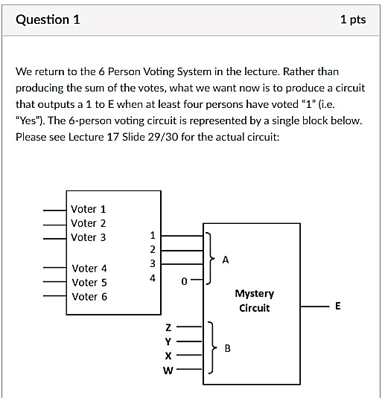
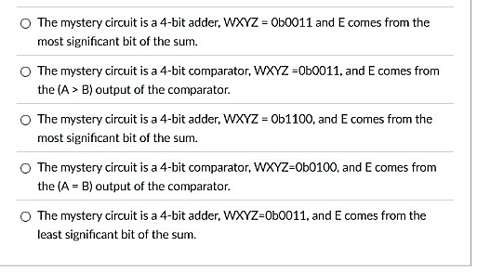
19. Combinational Circuits Quiz 1 Q1

Slide 31
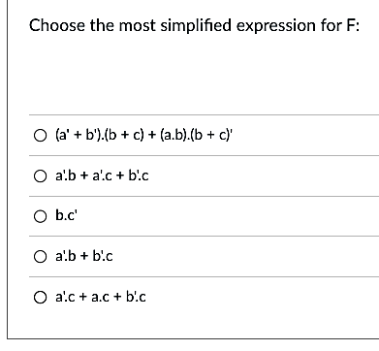
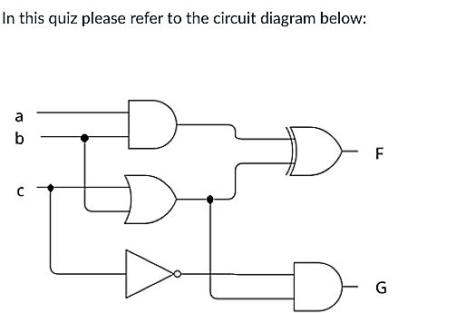
20. Combinational Circuits Quiz 2 Q1
w=a⋅b
x=b+c
c'
F = w ⊕ x
= w'⋅x + w⋅x'
= (a.b)'⋅(b+c) + (a.b)⋅(b+c)'
= (a'+b').(b+c) + (a.b).(b'.c')
= a'.b + a'.c + b'.b + b'.c + a.b.b'.c'
= a'.b + a'.c + 0 + b'.c + 0
= a'.b + a'.c + b'.c
= a'.b + b'.c
Concensus Theorem:
X⋅Y + X'⋅Z + Y⋅Z = X⋅Y + X'⋅Z

Slide 32
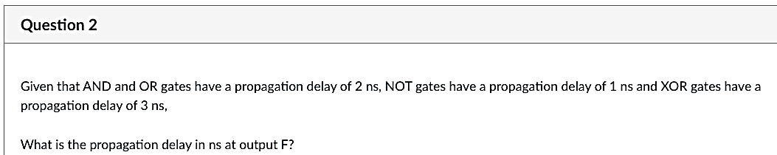
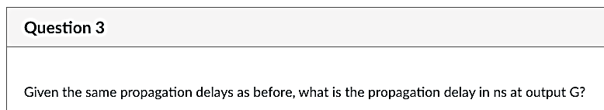
20. Combinational Circuits Quiz 2 Q2, Q3
2ns
3ns
2ns
1ns
2ns
5ns
4ns

Slide 33
Past YEARs’ QUESTIONS
Combinational Circuits

Slide 34
Past years’ exam questions
AY2020/21 Sem2 Q13(d)
AY2021/22 Sem1 Q13(a)
AY2021/22 Sem2 Q14(b)(c)
AY2023/24 Sem1 Q17(a)(b)(d)
Assumption
Logical constants 0 and 1 are available, but not complemented literals.

Slide 35
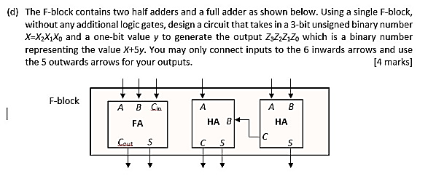
AY2020/21 Sem2 Q13(d)

Slide 36
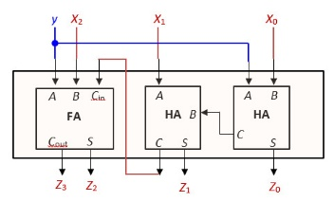
AY2020/21 Sem2 Q13(d)
Z = X + 5y
When y=0: Z₃Z₂Z₁Z₀ = X₂X₁X₀ + 000
When y=1: Z₃Z₂Z₁Z₀ = X₂X₁X₀ + 101

Slide 37
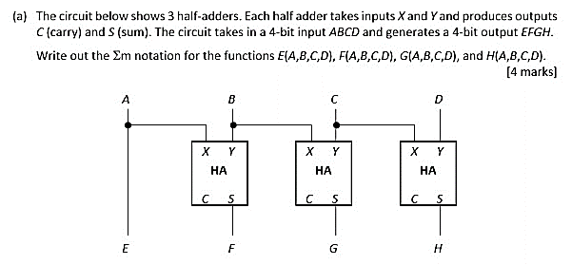
AY2021/22 Sem1 Q13(a)
A | B | C | D | E | F | G | H
0 | 0 | 0 | 0
0 | 0 | 0 | 1
0 | 0 | 1 | 0
0 | 0 | 1 | 1
0 | 1 | 0 | 0
0 | 1 | 0 | 1
0 | 1 | 1 | 0
0 | 1 | 1 | 1
1 | 0 | 0 | 0
1 | 0 | 0 | 1
1 | 0 | 1 | 0
1 | 0 | 1 | 1
1 | 1 | 0 | 0
1 | 1 | 0 | 1
1 | 1 | 1 | 0
1 | 1 | 1 | 1
0
0
0
0
0
0
0
0
1
1
1
1
1
1
1
1
0
0
0
0
1
1
1
1
1
1
1
1
0
0
0
0
0
0
1
1
1
1
0
0
0
0
1
1
1
1
0
0
0
1
1
0
0
1
1
0
0
1
1
0
0
1
1
0
E(A,B,C,D) = ∑m(8,9,10,11,12,13,14,15)
F(A,B,C,D) = ∑m(4,5,6,7,8,9,10,11)
G(A,B,C,D) = ∑m(2,3,4,5,10,11,12,13)
H(A,B,C,D) = ∑m(1,2,5,6,9,10,13,14)

Slide 38
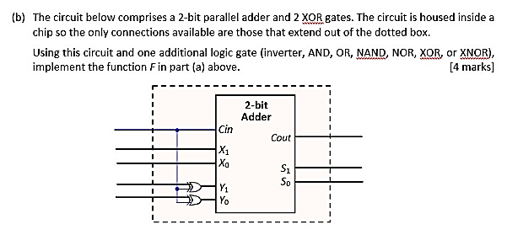
AY2021/22 Sem2 Q14(b)
Part (a) answer: F = ∑m(0, 5, 10, 15)
A | B | C | D | F
0 | 0 | 0 | 0 | 1
0 | 0 | 0 | 1 | 0
0 | 0 | 1 | 0 | 0
0 | 0 | 1 | 1 | 0
0 | 1 | 0 | 0 | 0
0 | 1 | 0 | 1 | 1
0 | 1 | 1 | 0 | 0
0 | 1 | 1 | 1 | 0
1 | 0 | 0 | 0 | 0
1 | 0 | 0 | 1 | 0
1 | 0 | 1 | 0 | 1
1 | 0 | 1 | 1 | 0
1 | 1 | 0 | 0 | 0
1 | 1 | 0 | 1 | 0
1 | 1 | 1 | 0 | 0
1 | 1 | 1 | 1 | 1
1
A
B
C
D
F
What is this circuit?
Since F=1 when AB=CD, or AB – CD = 0, the solution is…
It is a 2-bit adder-cum-substractor. If Cin is set to 0, it performs X + Y.
If Cin is 1, it performs X – Y.

Slide 39
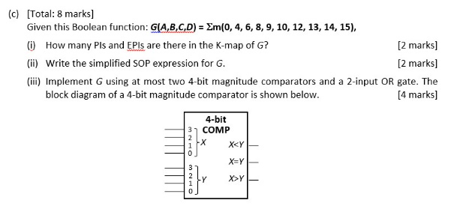
AY2021/22 Sem2 Q14(c)
G
C
1
0
0
0
A | B | C | D | G
0 | 0 | 0 | 0 | 1
0 | 0 | 0 | 1 | 0
0 | 0 | 1 | 0 | 0
0 | 0 | 1 | 1 | 0
0 | 1 | 0 | 0 | 1
0 | 1 | 0 | 1 | 0
0 | 1 | 1 | 0 | 1
0 | 1 | 1 | 1 | 0
1 | 0 | 0 | 0 | 1
1 | 0 | 0 | 1 | 1
1 | 0 | 1 | 0 | 1
1 | 0 | 1 | 1 | 0
1 | 1 | 0 | 0 | 1
1 | 1 | 0 | 1 | 1
1 | 1 | 1 | 0 | 1
1 | 1 | 1 | 1 | 1
1
0
0
1
B
1
1
1
1
A
1
1
0
1
D
5 PIs
5 EPIs
G = A·B + C'·D' + A·C' + B·D' + A·D'
0
0
A
B
0
0
D
C
G
Observation: G = (AB ≥ DC)
(Other answers possible. Eg: ABC $≥$ DCB, ABCD $≥$ DCBA).

Slide 40
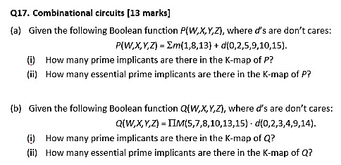
AY2023/24 Sem1 Q17(a)
4 PIs: Y'⋅Z, X’⋅Y’, X’⋅Z’, W⋅X⋅Z
0 EPI
Y
P
d
1
0
d
0
d
0
0
X
0
1
d
0
W
1
d
0
d
Z

Slide 41
AY2023/24 Sem1 Q17(b)
4 PIs: W'⋅X’, W’⋅Z’, X’⋅Z, X⋅Z’
2 EPIs: X’⋅Z, X⋅Z’
Y
Q
d
1
d
d
d
0
0
1
X
1
0
0
d
W
0
d
1
0
Z

Slide 42
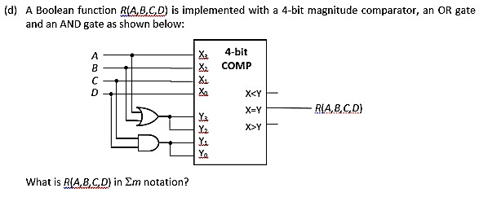
AY2023/24 Sem1 Q17(d)
A | B | C | D | R
0 | 0 | 0 | 0 | 1
0 | 0 | 0 | 1 | 0
0 | 0 | 1 | 0 | 0
0 | 0 | 1 | 1 | 1
0 | 1 | 0 | 0 | 0
0 | 1 | 0 | 1 | 0
0 | 1 | 1 | 0 | 0
0 | 1 | 1 | 1 | 0
1 | 0 | 0 | 0 | 0
1 | 0 | 0 | 1 | 0
1 | 0 | 1 | 0 | 0
1 | 0 | 1 | 1 | 0
1 | 1 | 0 | 0 | 1
1 | 1 | 0 | 1 | 0
1 | 1 | 1 | 0 | 0
1 | 1 | 1 | 1 | 1
R(A,B,C,D) = Σm(0,3,12,15).

Slide 43
Next Week
MSI Components:
Decoders, Encoders, Multiplexers, Demultiplexers
Past years’ exam questions:
AY2016/17 Sem2 Q2
AY2017/18 Sem2 Q3(a)(b)(c)
AY2018/19 Sem2 Q5(c)
AY2019/20 Sem2 Q5(a)(b)

Slide 44
End of File

